Slide 1
Siya Health®
We started with patients. Not software.
Physician-led ADHD + primary care telehealth · four states (CA · TX · PA · FL)
1 / 15
Notes:
Company name big, descriptive tagline, no date (OpenVC rule).

Slide 2
Siya Health®
The problem
Patients weren’t failing to find care. Care was failing to follow them.
Visit
→
Plan
→
Pharmacy
→
Follow-up
→
Refill
→
Life
Everyone optimizes the first visit.
Care actually breaks down at Pharmacy · Follow-up · Refill.
I was strict about controlled substances in my own training, long before Siya existed. I'd read about companies getting sued for overprescribing, and I didn't want us to become another cautionary tale. So the pill counts, the random drug screens, the compliance formalities — none of that came from a regulation checklist. It came from not wanting my name attached to a company that cut corners on this.
— Dr. Sneh Pandey
2 / 15
Notes:
Problem + founder pull-quote (not a card). Voice is first-person and unpolished on purpose — do not rewrite into consultant bullets.

Slide 3
Siya Health®
The solution
So we built the missing pieces ourselves.
Physicians → Operators → Systems builders
Multi-state licensure
CA · TX · PA · FL — providers credentialed and compliant in every state we serve.
Offshore clinical operations
Hired, trained, and QA’d from scratch — scheduling, pharmacy coordination, patient follow-up.
Standardized provider workflows
Protocols and SOPs shared across all providers and states — care doesn’t depend on memory.
3 / 15
Notes:
Solution = the operating model, built by doing.

Slide 4
Siya Health®
Product
The care journey we run today — end to end.
What we deliver today
End-to-end ADHD care, held together by our protocols and clinical judgment.
01
02
03
04
05
06
Symptoms
→
Eval
→
Assessment
→
Review
→
Plan
→
Execute · monitor
Escalation branch
When care stalls (pharmacy · side effects · missed follow-up · refill risk) → escalate → re-enter Review → Plan → Execute. Continuity is the process.
What we’re building
Concept — in design, informed by workflows already validated in our practice.
Care Timeline
Provider Workspace
Refill / Follow-up
· Visit · 06/12
· Patient context
· Queue · open
· Plan shared
→
· Protocol checklist
→
· Pharmacy hold
· Follow-up due
· Next action
· Due this week
· Refill request
· Handoff ready
· Closed
Flowchart = care we run today. Wireframe = software encoding that journey (supporting).
4 / 15
Notes:
PRODUCT — PRIMARY visual is the patient-journey flowchart. SECONDARY is the concept wireframe (Care Timeline → Provider Workspace → Refill/Follow-up) with required concept label. NO vendor names (Carepatron/Spruce/Creyos). NO Creyos report. Wireframe must not overpower the flowchart.

Slide 5
Siya Health®
Traction
Revenue nearly 3× since February. Cash-flow positive.
Monthly gross revenue — 2026
92
76
2,000+
1,000+
57
Patients treated
ADHD evaluations
44
47
33
30
150+
600+
Recurring members
Reviews · 4.8★
4 states
Cash-flow+
Jan
Feb
Mar
Apr
May
Jun
Jul
CA · TX · PA · FL
Operations
$ thousands / month · gross
$378k+ gross 2026 YTD (Jan–Jul) · founder-confirmed books.
5 / 15
Notes:
Action title with real growth claim (Feb $30k → Jul $92k). No vanity %.

Slide 6
Siya Health®
Where we are, honestly
Our growth engine today is founder-led — and it works.
Proof
Risk
Fix
Founder-led relationships and networking — on top of a full clinical load — fill all providers’ panels, not just the founder’s own.
That is a key-person dependency. We say so plainly.
This round funds clinical capacity and redundancy, so proven acquisition runs without routing every relationship through one person.
Proof + risk + fix — not a disclosure buried in an appendix.
6 / 15
Notes:
Differentiator slide. Keep.

Slide 7
Siya Health®
Business model
Cash-pay, recurring, no insurance risk.
$149
$79 / mo
$149 / mo
Initial evaluation
Ongoing care — non-controlled
Ongoing care — controlled
One-time, self-pay
Recurring membership
Recurring membership
Subscription-style continuity: 150+ recurring members and growing.
Roughly $600 per patient-year in professional fees (bottom-up, competitor-benchmarked).
Cash-pay means no payer contracts, no reimbursement risk, and revenue from day one.
7 / 15
Notes:
ARPU + model + why-this-model, per OpenVC. $149/$79/$149 canonical pricing.

Slide 8
Siya Health®
Market — bottom-up
15.5M diagnosed adults. $2.9B serviceable today.
Layer
Definition
Size
TAM
U.S. adult ADHD clinical services (professional fees)
~$10B
SAM
Adult ADHD virtual care (telehealth-willing, cash-pay comps)
~$2.9B
SOM
Year-3, capacity-derived (~40 clinician FTEs)
~$16M
Built bottom-up: 15.5M diagnosed U.S. adults (CDC) · ~half already use telehealth for ADHD · ~$600/patient-year professional fees.
No inflated blended TAM. Full sizing workbook available in diligence.
8 / 15
Notes:
Bottom-up per ADHD-MARKET-SIZING-2026.md. Never cite $19B/$122B societal-burden numbers.

Slide 9
Siya Health®
Competition
Different job. Not a feature checklist.
Episodic telehealth
Optimizes first-visit volume, not continuity
Generic EHR tools
Records history, doesn't guide next action
Point cognitive tools
One-time score, not ongoing care
Traditional psychiatry
Access-limited, waitlist-bound
Siya
Continuity, evaluation through refill — 2,000+ patients
No feature matrix. No “everyone top-right” quadrant. The difference is the job we do.
9 / 15
Notes:
OpenVC Competition — categories only. One explicit difference sentence per row. Language locks: practice/workflow/protocol — no OS/platform/SiyaOS.

Slide 10
Siya Health®
Go-to-market
A process — not a channel wishlist.
01 · Today
Primary engine
Founder-led relationships and networking fill all providers’ panels — not just the founder’s.
02 · Live test
Texas Search
Paid Search live in Texas; conversion tracking finalized Aug 2, 2026.
03 · Transition
This round’s job
Add clinical capacity, then move from founder-led fill to systematic acquisition — reproduce Search TX → CA.
04 · Measurement
No guessing
Full CAC and payback period confirmed by August 30, 2026.
10 / 15
Notes:
OpenVC GTM — process not channels. No fabricated conversion count. Tracking finalized Aug 2, 2026; CAC by August 30, 2026.

Slide 11
Siya Health®
Why now
The playbook is proven. The environment rewards how we practice.
Texas
Early conversions confirmed in Texas — full CAC by Aug 30, 2026.
California
Revenue growing — next market for the same playbook
Regulation
Environment rewards protocolized, auditable care over low-touch mills
Discipline
SOPs, QA, and multi-state compliance already in place
11 / 15
Notes:
Hook/why-now. No AI hype.

Slide 12
Siya Health®
Use of funds
We’re raising $500k to scale a working practice.
01
Clinical capacity & redundancy
More providers and coverage — directly reduces founder key-person risk.
02
Scale proven acquisition
Early conversions confirmed in Texas — full CAC by Aug 30, 2026.
03
Working capital buffer
Operate from strength, not desperation.
Objective: 18–24 months of runway to prove the playbook in a second state and remove key-person dependency.
12 / 15
Notes:
Round size + objective + use of proceeds (OpenVC funding-slide spec).

Slide 13
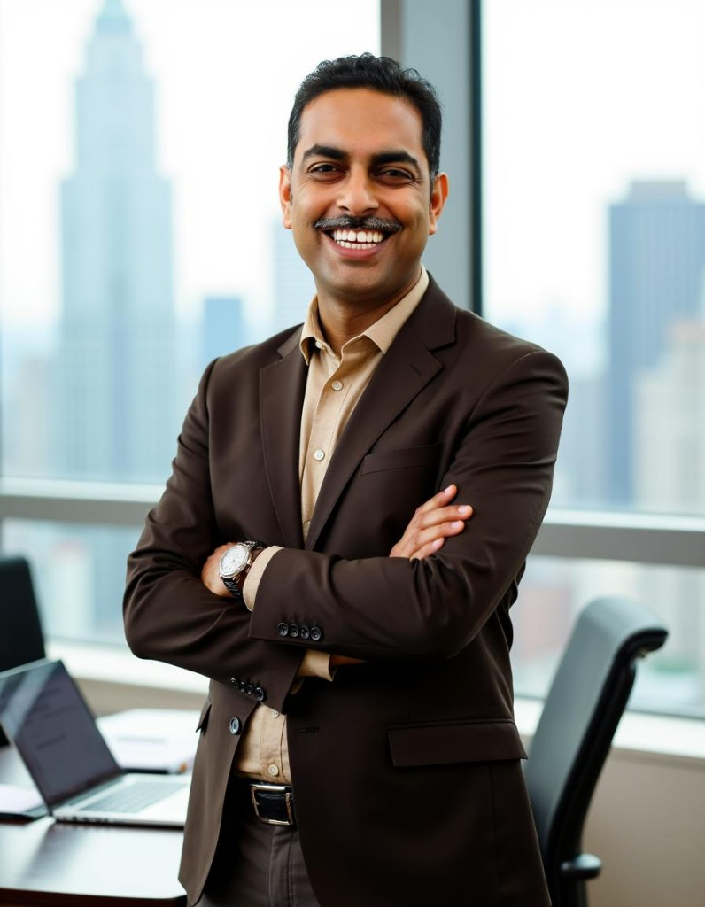

Siya Health®
Founders
Physicians who built the practice before asking for capital.
Dr. Sneh Pandey
Dr. Swati Pandey
Founder · CEO
Co-founder
· Board-certified physician
· 10,000+ patient encounters at Siya Health across primary care, obesity, hospital medicine, and ADHD care
· Built multi-state practice to 2,000+ patients, cash-flow positive, bootstrapped
· Board-certified physician, licensed in Pennsylvania
· Co-founder and clinical advisor — shapes clinical protocol standards across Siya Health
13 / 15
Notes:
Founder-confirmed 2026-08-02. Sneh: 10,000+ encounters (not patients) at Siya Health — distinct from 2,000+ unique patients on Traction. Swati: PA license + clinical advisor framing.

Slide 14
Siya Health®
Years spent learning how to deliver better care. This round scales what already works.
Seed round
$500,000
Clinical capacity & redundancy · Proven acquisition, next state · Working capital
14 / 15
Notes:
Ask stated plainly.

Slide 15
Siya Health®
Let’s talk.
Dr. Sneh Pandey · Founder & CEO
chiefservant@siya.health
siya.health
15 / 15
Notes:
OpenVC rule: CEO's direct email — not care@/info@. Set CEO_EMAIL in the builder.

